Slide 1
Foot Printing / Scanning Tools Lect 4 – NETW 4006

Slide 2
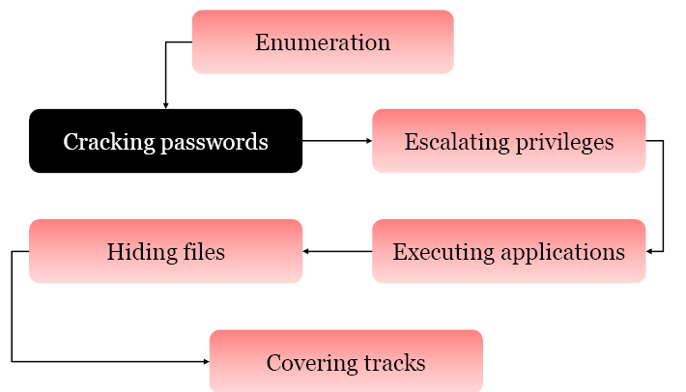
Reconnaissance

Slide 3
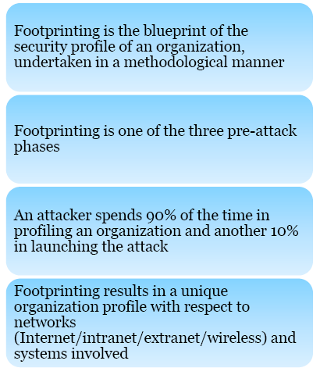
Foot printing
photographic print of plans or technical drawings .
Notes:
Blueprint - photographic print of plans or technical drawings etc.

Slide 4
Why ? foot printing necessary
photographic print of plans or technical drawings : -
something intended as a guide for making something else

Slide 5
Areas & Information which Attackers Seek
Notes:
Enumeration – Details
An intranet is a computing service that is run over a local area network, containing files within a webpage that is not publicly accessible to the public and requires authentication. If the intranet service can be accessed outside of a company, than it becomes an extranet, meaning that it would have a gateway to and from the internet, allowing public access to the service. Rather than being stored onto a public internet server, the extranet would be stored normally in the company's private server.

Slide 6
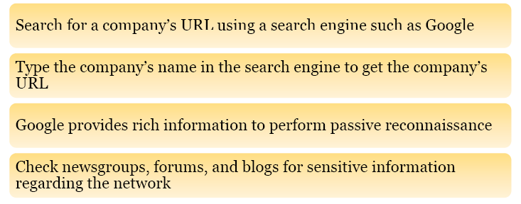
Information Gathering

Slide 7
People search
www.peoplefinders.com
www.Spokeo.com

Slide 8
Extracting Archive of a Website
Archive – Records, Files, documents
Notes:
Archive – Records, Files, documents

Slide 9
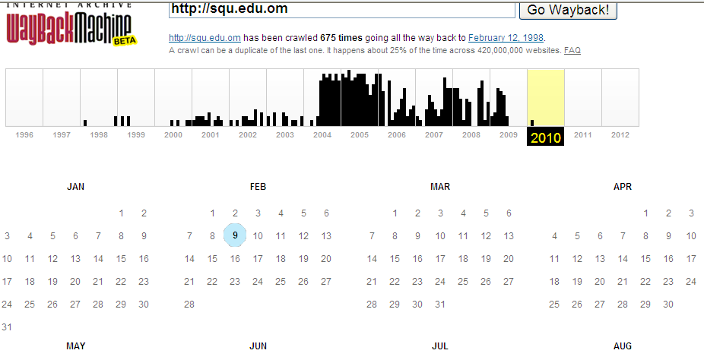
Switchboard http://www.switchboard.com

Slide 10
Foot printing Thorough Job Sites

Slide 11
Cont.

Slide 12
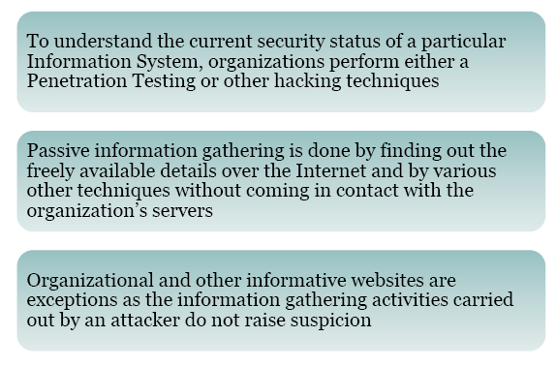
Passive Information Gathering
A penetration test, is a method of evaluating the security of a computer system or network by simulating an attack from malicious outsiders (who do not have an authorized means of accessing the organization's systems) and malicious insiders (who have some level of authorized access).
Notes:
A penetration test, occasionally pentest, is a method of evaluating the security of a computer system or network by simulating an attack from malicious outsiders (who do not have an authorized means of accessing the organization's systems) and malicious insiders (who have some level of authorized access).

Slide 13
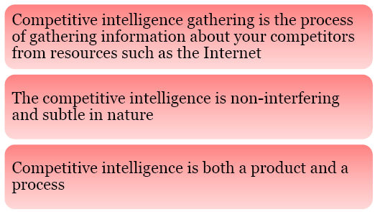
Competitive Intelligence Gathering
Notes:
Subtle – slight

Slide 14
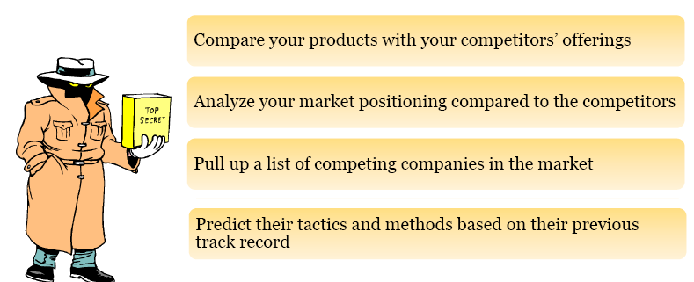
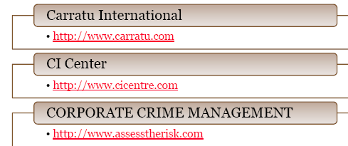
Why do you need Competitive Intelligence
http://www.bidigital.com/ci/

Slide 15
Foot Printing Tools

Slide 16
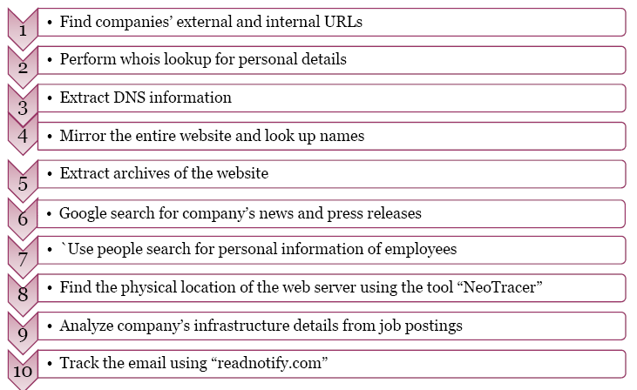
Steps to perform Foot Printing

Slide 17
Scanning

Slide 18
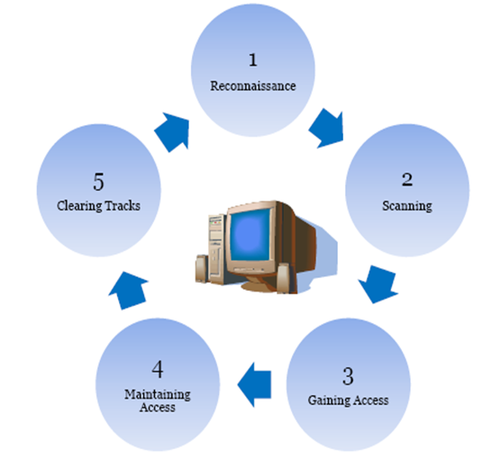
Scanning - Definition

Slide 19
Types of scanning

Slide 20
Objective of scanning

Slide 21
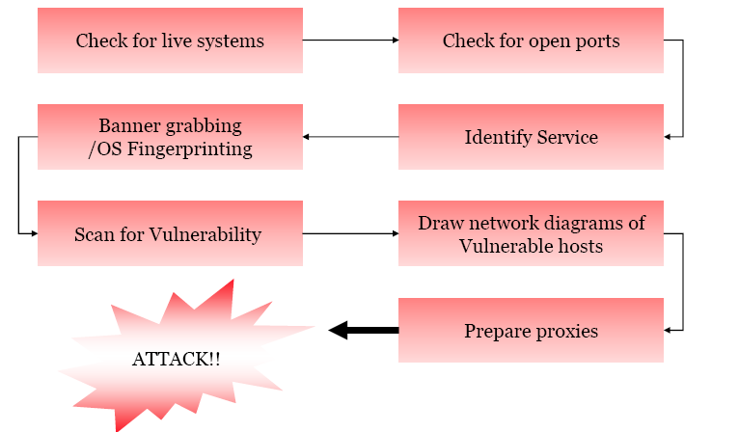
Methodology

Slide 22
Checking for Live systems – ICMP Scanning

Slide 23
Examples of Scanning Tools
Angry IP Scanner
Ping Sweep
NMAP
NetScan
WUPS-UDP Scanner
IP Scanner
Global Network Inventory Scanner
Inflirtrator
LanView
WotWeb

Slide 24
Banner Grabbing OS Fingerprinting

Slide 25
Active & Passive
Passive foot printing means there’s no direct touch to the target
Notes:
Passive foot printing means there’s no direct touch to the target. It’s information that you gather from other sources, not the target itself. So, going to a company’s website would be a direct touch. That wouldn’t be passive, that would be an active foot printing technique.
Further examples in this distinction of passive vs. active foot printing are that active foot printing techniques directly touch things like websites. Web servers, banner grabbing web servers, banner grabbing FTP servers are examples of this. Those are the types of active foot printing. They’re still not attacks or penetration, but they’re gathering information in a more direct fashion.
So pinging a site and trace routing a site so you are actually grabbing all of the information from a site is a technique called mirroring where you’re downloading every bit of data you possibly can find from a website. It may not be a security violation, but it is certainly an active attack or an active foot printing technique.

