Slide 1
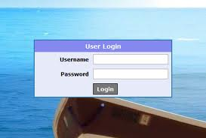
NETW4005 COMPUTER SECURITY A
LECTURE – 2
USER AUTHENTICATION

Slide 2
CONTENT
2.1 USER AUTHENTICATION
2.2 MEANS OF USER AUTHENTICATION
2.3 PASSWORD AUTHENTICATION
2.4 PASSWORD VULNERABILITIES
2.5 USE OF HASHED PASSWORDS – IN UNIX
2.6 PASSWORD CRACKING TECHNIQUES
2.7 USING BETTER PASSWORDS
2.8 TOKEN AUTHENTICATION
2.9 BIOMETRIC AUTHENTICATION

Slide 3
2.1 USER AUTHENTICATION
RFC 2828 defines user authentication as:
“The process of verifying an identity claimed by or for a system entity.
Fundamental security building block
Basis of most types of access control & for user accountability.
User authentication is distinct from message authentication.
User authentication process consists of two steps:
1. Identification: Presenting an identifier to the security system.
2. Verification: Binding entity (person) and identifier

Slide 4
2.2 MEANS OF USER AUTHENTICATION
Four general means of authenticating a user's identity are
Individual knows: Includes a password, a personal identification number (PIN), or answers to a prearranged set of questions.
Individual possesses: Includes electronic keycards, smart cards, and physical keys. Also known as a token.
Individual is (static biometrics): Includes recognition by fingerprint, retina, and face.
Individual does (dynamic biometrics): Examples include recognition by voice pattern, handwriting characteristics, and typing rhythm.
can use alone or combined
all can provide user authentication & have issues.

Slide 5
2.3 PASSWORD AUTHENTICATION
Widely used user authentication method
User provides name/login and password
System compares password with that saved for specified login
Authenticates ID of user logging and
That the user is authorized to access system
Determines the user’s privileges
Is used in Discretionary Access Control

Slide 6
2.4 PASSWORD VULNERABILITIES
Offline dictionary attack
Specific account attack
Popular password attack
Password guessing against single user
Workstation hijacking
Exploiting user mistakes
Exploiting multiple password use
Eectronic monitoring

Slide 7
Following are the attack strategies:
1. Offline dictionary attack:
A hacker gain access to the system password file.
Compares the password hashes against hashes of commonly used passwords.
2. Specific account attack:
Attacker targets a specific account &submits password guesses until the correct password is discovered.
3. Popular password attack / Against single user:
The attacker chooses a popular password and tries it.
Attacker attempts to gain knowledge about the account holder and system password policies and uses that knowledge to guess the password.

Slide 8
4. Workstation hijacking:
The attacker waits until a logged-in workstation is unattended.
5. Exploiting user mistakes:
User is more likely to write it down passwords, because it is difficult to remember.
6. Exploiting multiple password use.
Similar password for a many applications
7. Electronic monitoring:
If a password is communicated across a network to log on to a remote system, it is vulnerable to eavesdropping.

Slide 9
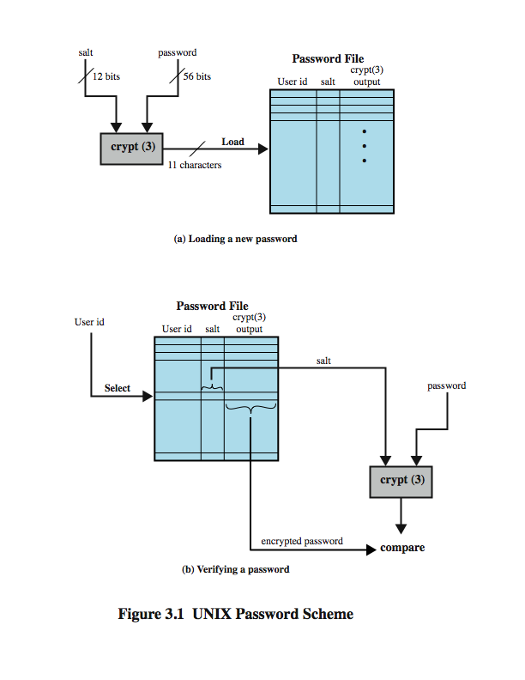
2.5 USE OF HASHED PASSWORDS – IN UNIX

Slide 10
A widely used password security technique.
Use of hashed passwords and a salt value.
Found on all UNIX and other operating systems.
1. Loading a new password:
The user selects or is assigned a password.
Password combined with a fixed-length salt value.
Salt is a pseudorandom or random number.
PW & salt serve as inputs to a hashing algorithm to produce a fixed-length hash code.
Hashed password then stored, together with a plaintext copy of the salt, in the password file for the corresponding user ID.
2. Verifying a password:
When a user attempts to log on to a system, the user provides an ID and a password.
OS uses the ID to retrieve the plaintext salt and the encrypted password.
The salt and user-supplied password are used as input to the encryption routine.
If the result matches the stored value, the password is accepted.
Notes:
There are two threats to this password scheme. First, a user can gain access on a machine using a guest account or by some other means and then run a password guessing program, called a password cracker, on that machine. In addition, if an opponent is able to obtain a copy of the password file, then a cracker program can be run on another machine at leisure. This enables the opponent to run through millions of possible passwords in a reasonable period.

Slide 11
2.6 PASSWORD CRACKING TECHNIQUES
Dictionary attacks
Develop a large dictionary of possible passwords and try each against the password file
Each password must be hashed using each salt value and then compared to stored hash values
Rainbow table attacks
Pre-compute tables of hash values for all salts
A mammoth table of hash values
Can be countered by using a sufficiently large salt value and a sufficiently large hash length

Slide 12
2.7 USING BETTER PASSWORDS
Clearly have problems with passwords
Goal to eliminate guessable passwords
At the same time, easy for user to remember
Four basic techniques:
User education
Computer-generated passwords
Reactive password checking
Proactive password checking
1. User education:
Users can be told the importance of using hard-to-guess passwords.
Provide users with guidelines for selecting strong passwords.
Can be problematic when have a large user population.
Because many users will simply ignore the guidelines.

Slide 13
2. Computer-generated passwords:
Poor acceptance by users.
Random in nature, users will not remember.
3. Reactive password checking:
System periodically runs its own password cracker to find guessable passwords.
The system cancels any passwords that are guessed and notifies the user.
Can be costly in resources to implement.
4. Proactive password checking:
User selects own password which the system then checks to see if it is allowable and, if not, rejects it.

Slide 14
2.8 TOKEN AUTHENTICATION
Objects that a user possesses for the purpose of user authentication are called tokens.
Token are of different forms, they are:
1. Embossed: Raised characters only, on front, e.g. Old credit card.
2. Magnetic stripe: Magnetic bar on back, characters on front, e.g. Bank card.
3. Memory: Has Electronic memory inside, e.g. Prepaid phone card.
4. Smartcard: Has Electronic memory and processor inside, e.g. Biometric ID card

Slide 15
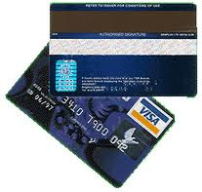
2.8.1 MEMORY CARD / MAGNETIC STRIPS
Store but do not process data
Magnetic stripe card, e.g. bank card
Electronic memory card
Used alone for physical access
With password/PIN for computer use
Drawbacks of memory cards include:
Need special reader
Loss of token issues
User dissatisfaction

Slide 16
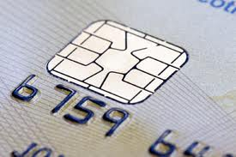
2.8.2 SMARTCARD / EMBOSED
Credit-Card like
Has own processor, memory, I/O ports
Wired or wireless access by reader
May have crypto co-processor
ROM, EEPROM, RAM memory
Executes protocol to authenticate with reader/computer
Also have USB dongles

Slide 17
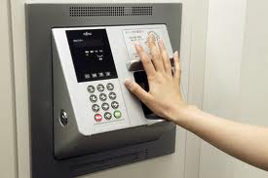
2.9 BIOMETRIC AUTHENTICATION
Authenticate user based on one of their physical characteristics
Biometric authentication system authenticates an individual based on unique
Physical characteristics like Fingerprints, hand geometry, facial characteristics, and retinal and iris patterns.
Dynamic characteristics like voiceprint and signature.

Slide 18
1. Facial characteristics:
Characteristics based on location and shape of key facial features, such as eyes, eyebrows, nose, lips, and chin shape.
2. Fingerprints:
The pattern of ridges and furrows on the surface of the fingertip.
3. Hand geometry:
Identify features of hand,: e.g. shape, lengths & widths of fingers.
4. Retinal pattern:
Formed by veins beneath the retinal surface is unique.
Uses digital image of the retinal pattern by projecting a low-intensity beam of visual or infrared light into the eye.
5. Signature: Each individual has a unique style of handwriting, especially in signature.

Slide 19
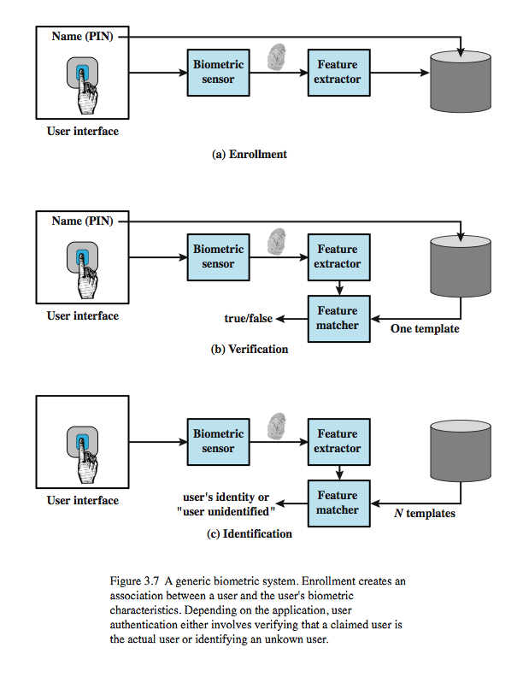
2.9.1 OPERATION OF A BIOMETRIC SYSTEM

Slide 20
Operation of a biometric system.
Each users must first be enrolled in the system.
For biometric system, the user presents a name and a password or PIN.
System senses some biometric characteristic of this user (e.g. fingerprint of right index finger).
The system digitizes the input and then extracts a set of features that can be stored as a number or set of numbers.
This set of numbers is referred to as the user’s template.
User authentication on a biometric system involves either verification or identification.
Verification is similar to a user logging on to a system by using a memory card or smart card coupled with a password or PIN.
In Identification process, the individual uses the biometric sensor but presents no additional information.
The system then compares the presented template with the set of stored templates. If there is a match, then this user is identified. Otherwise, the user is rejected.

