Slide 1
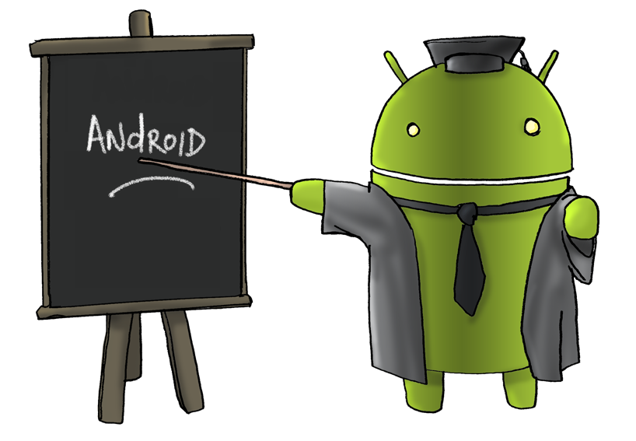
Mobile Application Development BSCS-7 Lecture # 1

Slide 2
Compulsory Reading Material
Prerequisites
Object Oriented Programming using Java
The Android™ Developer’s Cookbook-Building Applications with the Android SDK,
by Ronan Schwarz, Phil Dutson, James Steele, Nelson To (2nd Edition)
Learning Android (O’Reilly publisher) by Marko Garenta
Assessment & Evaluation Criteria
Quizzes 10 %
Assignments 10 %
Mid Term 20 %
Project 10 %
Final Term 50 %
Total: 100 %

Slide 3
Mobile Operating Systems
A mobile OS is an operating system for smartphones, tablets, PDAs, or other mobile devices.
Mobile OSs combine features of a personal computer OS with other features useful for mobile or handheld use; usually including, and most of the following considered essential in modern mobile systems;
touchscreen, cellular, Bluetooth, Wi-Fi, GPS mobile navigation, camera, video camera, speech recognition, voice recorder, music player, etc.
Some Current software platforms
Android (based on the Linux Kernel) is from Google Inc.
CyanogenMod and Cyanogen OS are based on the open source Android Open Source Project(AOSP).
Fire OS is an operating system launched by Amazon based on Google's AOSP.
iOS (previously known as iPhone OS) is from Apple Inc.
Windows Phone (Soon to be Windows 10 Mobile) is from Microsoft.
BlackBerry 10 (based on the QNX OS) is from BlackBerry.
Firefox OS is from Mozilla.

Slide 4
Introduction to Android
Android is an OS based on Linux with a Java programming interface. It is a comprehensive open source platform designed for mobile devices.
First beta version of Android Software Development Kit (SDK) was released by Google in 2007 where as first commercial version, Android 1.0, was released in September 2008.
Features of Android
Beautiful UI, Connectivity, Storage, Media support, Messaging, Web browser, Multi-touch, Multi-tasking, Resizable widgets, Multi-Language, GCM, Wi-Fi Direct, Android Beam
Android Applications
Android applications are usually developed in the Java language using the Android Software Development Kit.
Once developed, Android applications can be packaged easily and sold out either through a store such as Google Play, SlideME, Opera Mobile Store, Mobango, F-droid and the Amazon Appstore.

Slide 5
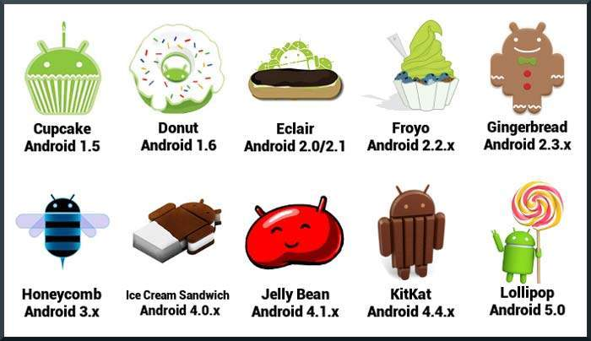
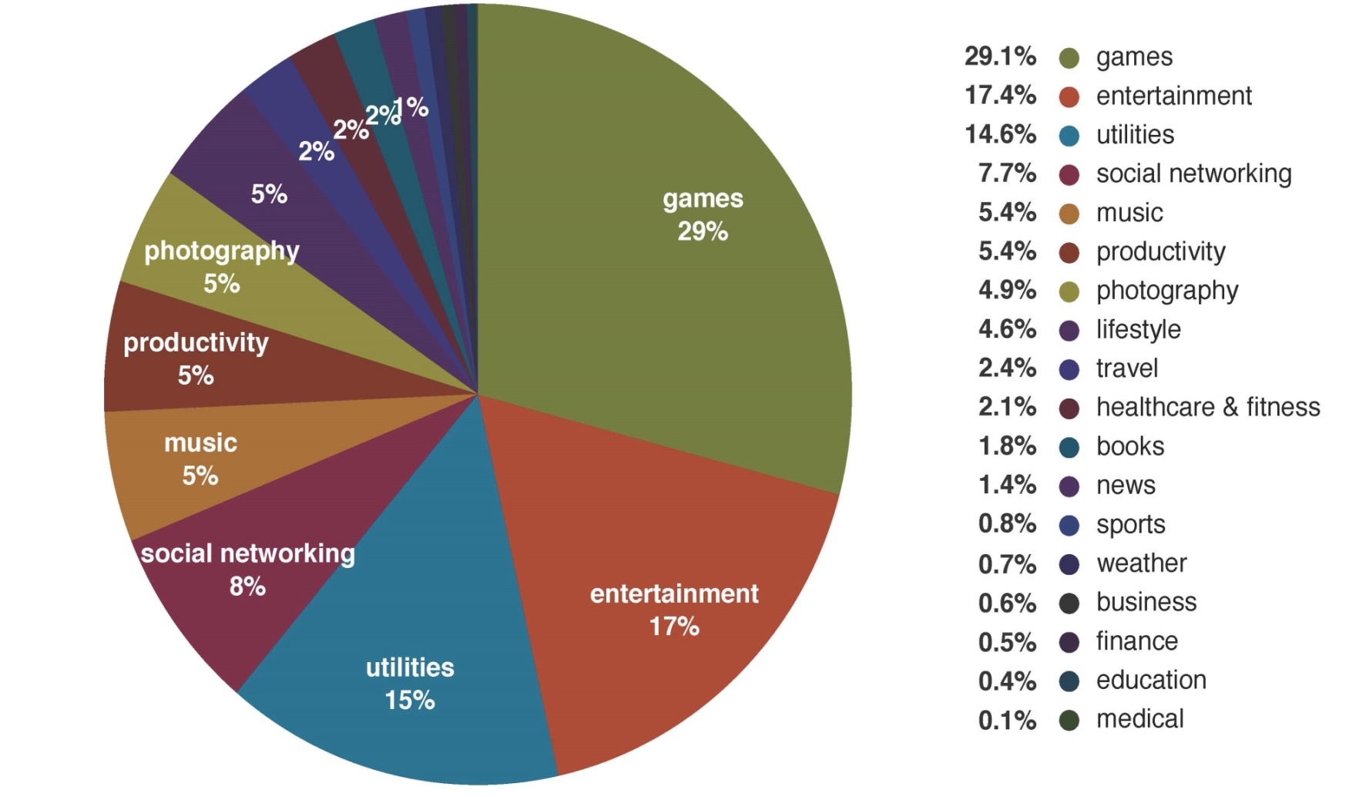
Introduction to Android
History of Android
The code names of android ranges from A to L currently, such as Aestro, Blender, etc…
Categories of Android applications

Slide 6
Requirements for Android
OS
Android application development on either of the following operating systems:
Microsoft Windows.
Mac OS X 10.5.8 or later version with Intel chip.
Linux including GNU C Library 2.7 or later.
Tools
All the required tools to develop Android applications are freely available and can be downloaded from the Web. Following is the list of software's you will need before you start your Android application programming.
Java JDK5 or later version
Android Studio / Android SDK and Eclipse IDE for Java Developers (optional) and Android Development Tools (ADT) Eclipse Plug-in (optional)

Slide 7
Requirements for Android
Download Android Studio
From http://developer.android.com/sdk/installing/index.html
System Requirements for Windows
Microsoft® Windows® 8/7/Vista (32 or 64-bit)
2 GB RAM minimum, 4 GB RAM recommended
400 MB hard disk space
At least 1 GB for Android SDK, emulator system images, and caches
1280 x 800 minimum screen resolution
Java Development Kit (JDK) 7
Optional for accelerated emulator: Intel® processor with support for Intel® VT-x, Intel® EM64T (Intel® 64), and Execute Disable (XD) Bit functionality

Slide 8
Installation
Java
Visit http://www.oracle.com/technetwork/java/javase/downloads/index.html
Install it.
Android Studio
Visit http://developer.android.com/sdk/index.html
click the button Download Android Studio.
Accept terms, and click Download.
Run executable file of setup.
Follow the setup wizard to install Android Studio and any necessary SDK tools.
On some Windows systems, the launcher script does not find where Java is installed. If you encounter this problem, you need to set an environment variable indicating the correct location.
Select Start menu > Computer > System Properties > Advanced System Properties. Then open Advanced tab > Environment Variables and add a new system variable JAVA_HOME that points to your JDK folder, for example C:\Program Files\Java\jdk1.7.0_45

Slide 9
Installation
The individual tools and other SDK packages are saved outside the Android Studio application directory. If you need to access the tools directly, use a terminal to navigate to the location where they are installed. For example:
\Users\<user>\sdk\
Android Studio is now ready and loaded with the Android developer tools, but there are still a couple packages you should add to make your Android SDK complete.
Run
Run Android Studio as Administrator.
Before you create new project, click Configure from splash screen. Click SDK Manager.
Don’t select all. In bottom, in Extra section, select Intel x86 Emulator Accelerator.
Click Install button.

Slide 10
Android Emulator
The Android SDK includes a mobile device emulator — a virtual mobile device that runs on your computer. The emulator lets you develop and test Android applications without using a physical device.
Limitations
No support for placing or receiving actual phone calls. You can simulate phone calls (placed and received) through the emulator console, however.
No support for USB connections
No support for device-attached headphones
No support for determining network connected state
No support for determining SD card insert/eject
No support for Bluetooth
AVD Manager
The AVD Manager provides a graphical user interface in which you can create and manage Android Virtual Devices (AVDs), which are required by the Android Emulator.
Android Studio
Tools > Android > AVD Manager

Slide 11
Optional Installation - Genymotion
Genymotion
It is a fast third party Android emulator for app testing and presentation on Windows that can be used instead of the default Android emulator. In some cases it's as good as or better than developing on actual devices!
Visit https://www.genymotion.com
Click Free version. Click Get Genymotion.
Create a Genymotion account, sign in.
Download and install Genymotion.
Run Genymotion
First time you have to sign in with your credentials. It will connect with cloud and provide available virtual devices.
Add your desired virtual device.

